Slide 1
18MES101L - Engineering Graphics and Design
Week 4: FUNDAMENTALS OF PROJECTION

Slide 2
Projection of Points
Point has simply position but no magnitude
Generally represented by a very small circle or a dot
Position of point
In orthographic projections space is divided into four quadrants
By two reference floor and wall.
Point may be situated in any one of these quadrants
It may also be on any one of the reference.

Slide 3
2nd Quadrant
VP
2nd Quad.
1ST Quad.
F.V.
1st Quadrant
Y
Observer
X Y
HP
X
3rdQuadrant
Observer
3rd Quad.
4th Quad.
4th Quadrant

Slide 4
Position of point
Point situated above Floor and in front of Wall is in First Quadrant.
Point situated above Floor and behind Wall is in Second Quadrant.
Point situated below Floor and behind Wall is in Third Quadrant.
Point situated below Floor and in front of Wall is in Fourth Quadrant.

Slide 5
Position of point cond..
In front of wall and above floor
In front of wall and in the floor
In the wall and above floor
Behind wall and above floor
Behind wall and in floor
Behind wall below floor
In wall below floor
In front of wall and below floor
In wall and floor

Slide 6
Position of point cond..
After knowing distances of point from both the reference, it is possible to find out its projections on floor and wall
By extending projectors perpendicular to both floor and wall
Projection on floor is called top view
Projection on wall is called front view

Slide 7
NOTATIONS
FOLLOWING NOTATIONS SHOULD BE FOLLOWED WHILE NAMEING
DIFFERENT VIEWS IN ORTHOGRAPHIC PROJECTIONS.
OBJECT POINT A LINE AB
IT’S TOP VIEW a a b
IT’S FRONT VIEW a’ a’ b’
IT’S SIDE VIEW a” a” b”

Slide 8
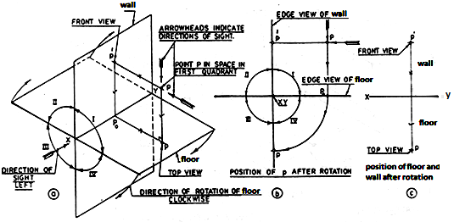
Direction of rotation of floor in clockwise

Slide 9
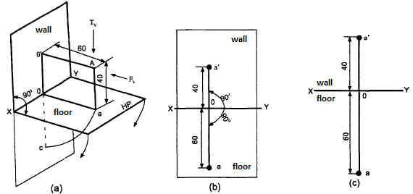
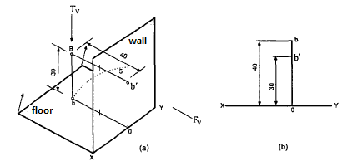
Example problems
1. Point A is 40 mm above floor and 60 mm in front of wall. Draw its front and top view.
2. A Point B is 30 mm above floor and 40 mm behind wall. Draw its projection.

Slide 10
Exercise
Draw the orthographic projections of the following points.
Point P is 30 mm above floor and 40 mm in front of wall
Point Q is 25 mm above floor and 35 mm behind wall
Point R is 32 mm below floor and 45 mm behind wall
Point S is 35 mm below floor and 42 mm in front of wall
Point T is in floor and 30 mm is behind wall
Point U is in wall and 40 mm below floor
Point V is in wall and 35 mm above floor
Point W is in floor and 48 mm in front of wall

Slide 11
PROJECTION OF LINES
A straight line is the shortest distance between two points.
Projections of the ends of any line can be drawn using the principles for the projections of points.
Top views of the two end points of a line, when joined give the top view of the line.
Front views of the two end points of the line ,when joined ,give the front view of the line. Both these projections are straight lines.

Slide 12
POSITION OF STRAIGHT LINE IN SPACE
The line in space may be parallel, perpendicular or inclined to either the floor or the wall or both of them
It may be in one or both the reference planes
The line ends may be in one or two quadrants.

Slide 13
Possible projections of straight lines with respect to wall and floor in the first quadrant are as follows:
Perpendicular to wall and parallel to the floor.
Perpendicular to floor and parallel to the wall.
Parallel to both wall and floor.
Parallel to wall and inclined to the floor.
Parallel to floor and inclined to the wall.
Inclined to both wall and floor.

Slide 14
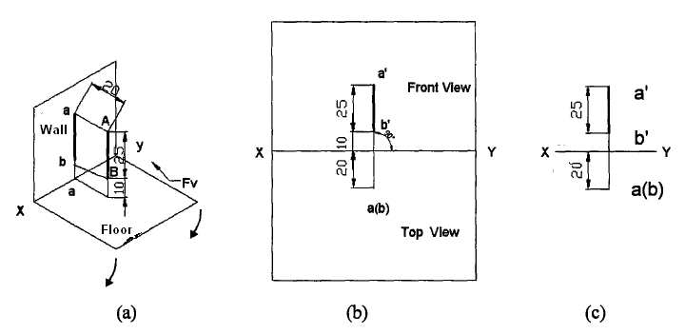
Line perpendicular to floor and parallel to wall

Slide 15
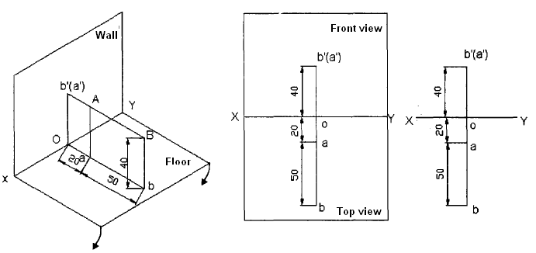
Line perpendicular to wall and parallel to floor
Problem: A line AB 50 mm long is perpendicular to wall and parallel to floor. Its end A is
20 mm in front of wall and the line is 40 mm above floor. Draw the projections of the line.

Slide 16
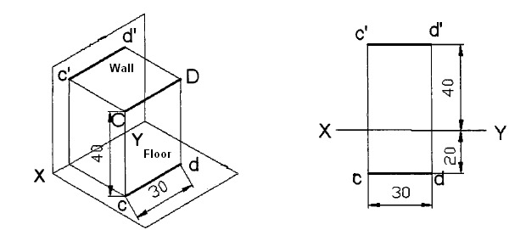
Line parallel to both the wall and floor
Problem : A line CD 30 mm long is parallel to both wall and floor. The line is 40 mm above floor and 20 mm in front of wall. Draw its projection.

Slide 17
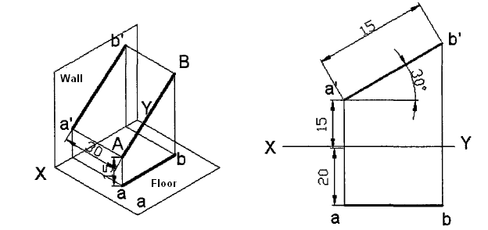
Line parallel to wall and inclined to floor
Problem: A line AB 40 mm long is parallel to wall and inclined at an angle of 30⁰ to floor. The end A is 15 mm above floor and 20 mm in front of wall. Draw the projections of the line.

Slide 18
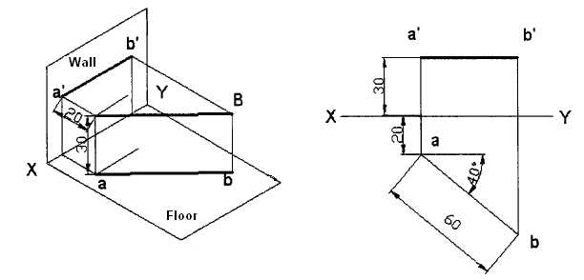
Line parallel to floor and inclined to wall
Problem: Draw the projections of straight line AB 60 mm long parallel to floor and inclined at an angle of 40⁰ to wall. The end A is 30 mm above floor and 20 mm in front of wall.

Slide 19
INCLINED to both HP & VP
PROBLEM :
Line AB is 75 mm long and it is 30⁰ & 40⁰ inclined to HP & VP respectively. End A is 12mm above HP and 10 mm in front of VP. Draw projections. Line is in 1st quadrant.
b´
b´₁
Solution steps:
1) Draw XY line and one projector.
2) Locate a´ 12mm above XY line
& a 10mm below XY line.
3) Take 30⁰ angle from a´ & 40⁰ from a and mark TL, i.e., 75mm on both lines. Name those points b₁´ and b respectively.
4) Draw horizontal component of TL a b₁ from point b₁ and name it 1. (the length a-1 gives length of FV as we have seen already)
5) Extend it up to locus of a and rotating a’ as center locate b´ as shown. Join a´ b´ as FV.
6) From b´ drop a projector downward & get point b. Join a & b, i.e., TV.
FV
TL
θ
a´
X
Y
a
LFV
1
Ø
TV
TL
b
b₁

Slide 20
FINDING INCLINATION WITH HP
PROBLEM :
Line AB 75mm long makes 45⁰ inclination with VP while it’s FV makes 55⁰. End A is 10 mm above HP and 15 mm in front of VP. If line is in 1st quadrant draw it’s projections and find it’s inclination with HP.
Solution Steps:-
1.Draw xy line.
2.Draw one projector for a’ & a
3.Locate a´ 10mm above XY & a 15 mm below XY.
4.Draw a line 45⁰ inclined to XY from point a and cut TL 75 mm on it and name that point b_{1.}
5.Draw locus from point b_{1.}
6.Take 55⁰ angle from a´ for FV above XY line.
7.Draw a vertical line from b₁ up to locus of a and name it 1. It is horizontal component of
TL & is LFV.
8.Continue it to locus of a´ and rotate upward up to the line of FV and name it b´. This a´ b´ line is FV.
9. Drop a projector from b´ on locus from point b₁ and name intersecting point b. Line ab is TV of line ab.
10.Draw locus from b´ and with TL distance cut point b₁´
11.Join a´ b₁´ as TL and measure it’s angle α at a´. It will be true angle of line with HP.
b´
b´ ₁
LOCUS OF b₁´
FV
TL
55⁰
α
a´
X
Y
a
LFV
1
45⁰
TV
TL
LOCUS OF b₁
b
b₁

Slide 21
FINDING TRUE LENGTH AND INCLINATIONS
PROBLEM : FV of line AB is 50⁰ inclined to XY and measures 55 mm long while it’s TV is 60⁰ inclined to XY line. If end A is 10 mm above HP and 15 mm in front of VP, draw it’s projections, find TL, inclinations of line with HP & VP.
b’
b’₁
Solution steps:
1.Draw XY line and one projector.
2.Locate a’ 10 mm above XY and a 15 mm below XY line.
3.Draw locus from these points.
4.Draw FV 50⁰ from a’ and
mark b’ cutting 55mm on it.
5.Similarly draw TV 60⁰ from a & drawing projector from b’
locate point b and join a b.
6.Then rotating views as shown, locate True Lengths ab₁ & a’b₁’ and their angles with HP and VP.
FV
TL
50⁰
a’
X
Y
a
60⁰
TV
TL
b
b₁

Slide 22
FINDING ANGLE WITH HP & VP
PROBLEM:-
Line AB is 75 mm long. It’s FV and TV measure 50 mm & 60 mm long respectively. An end is 10 mm above HP and 15 mm in front of VP. Draw projections of line AB if end B is in first quadrant. Find angle with HP and VP.
b’
b’₁
SOLUTION STEPS:
1.Draw XY line and one projector.
2.Locate a’ 10 mm above XY and
a 15 mm below XY line.
3.Draw locus from these points.
4.Cut 60mm distance on locus of a’
& mark 1’ on it as it is LTV.
5.Similarly cut 50mm on locus of a
and mark point 1 as it is LFV.
6.From 1’ draw a vertical line upward
and from a’ taking TL (75mm ) in
compass, mark b’₁ point on it.
Join a’ b’₁ points.
7. Draw locus from b’₁
8. With same steps below get b₁ point
and draw also locus from it.
9. Now rotating one of the components
i.e., a-1 locate b’ and join a’ with it
to get FV.
10. Locate TV similarly and measure
angles
FV
TL
θ
LTV
1’
a’
X
Y
a
LFV
Φ
1
TV
TL
θ and Φ
b
b₁

Slide 23
FINDING ANGLE WITH HP & VP
PROBLEM 11:- TV of a 75 mm long line CD, measures 50 mm. End C is in HP and 50 mm in front of VP. End D is 15 mm in front of VP and it is above HP. Draw projections of CD and find angles with HP and VP.
SOLUTION STEPS:
d’
d’₁
LOCUS OF d’
1.Draw XY line and one projector.
2.Locate c’ on XY and c 50mm below XY line.
3.Draw locus from these points.
4.Draw locus of d 15 mm below XY.
5.Cut 50mm & 75 mm distances on
locus of d from c and mark points
d & d₁ as these are TV and TL. Join both with c.
6.From d₁ draw a vertical line upward up to XY i.e., up to locus of c’ and draw an arc as shown.
7 Then draw one projector from d to meet this arc in d’ point & join c’ d’
8. Draw locus of d’ and cut 75 mm
on it from c’ as TL
9.Measure angles
FV
TL
c’
θ
X
Y
d
d₁
LOCUS OF d
TL
TV
θ and Φ
Φ
c

Slide 24
PROJECTION OF PLANES
A plane figure has two dimensions, the length and breadth.
It may be of any shape such as triangular, square, pentagonal, hexagonal, circular etc.

Slide 25
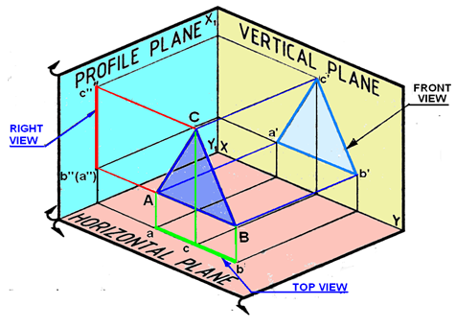
Projections of a Plane surface
A: Plane surface parallel to one plane and perpendicular to the other two
Figure 1. Projections of a triangular lamina on the projection planes

Slide 26
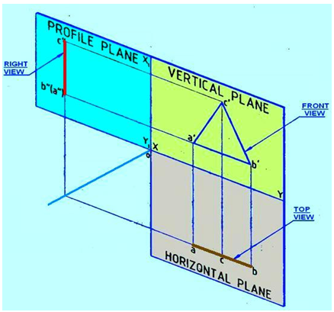
Figure 2. Rotation of PP and HP after projection

Slide 27
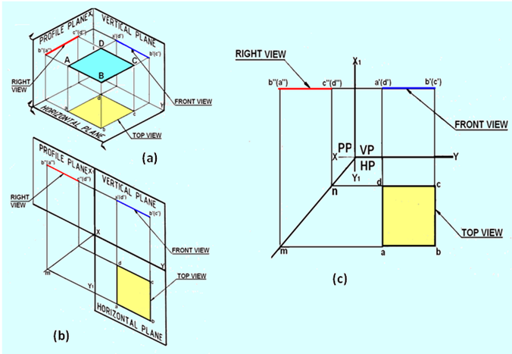
B) Plane parallel to HP and perpendicular to both VP and PP
Figure 4. Projections of the lamina with its surface parallel to HO and perpendicular to both VP and PP

Slide 28
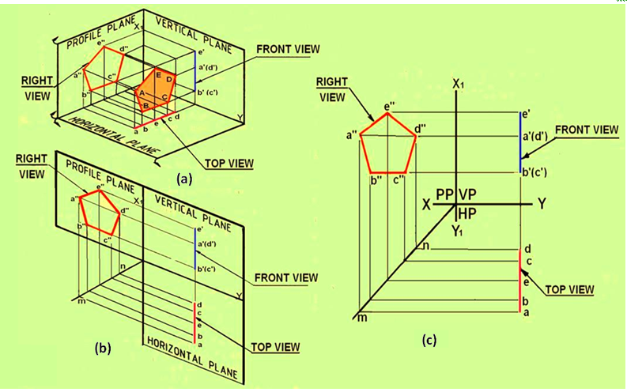
Plane parallel to PP and perpendicular to both HP and VP
Figure 5 Projections of a pentagonal lamina with its surface parallel to PP and perpendicular to HP and VP

Slide 29
The possible orientations of the planes with respect to the wall and floor of projection are:
Plane parallel to wall and perpendicular to the floor.
Plane parallel to floor and perpendicular to the wall.
Plane perpendicular to both wall and floor.
Plane inclined to wall and perpendicular to the floor.
Plane inclined to floor and perpendicular to the wall.
Plane inclined to both wall and floor.

Slide 30
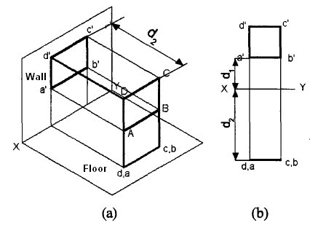
Plane parallel to wall and perpendicular to the floor

Slide 31
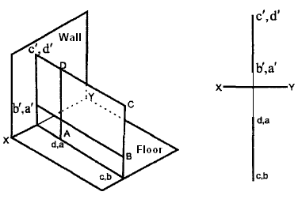
Plane perpendicular to both wall and floor

Slide 32
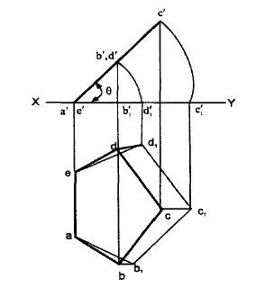
Plane inclined to floor and perpendicular to the wall.

Slide 33
Problems
A regular pentagon ABCDE, of side 25 mm side has its side BC on floor. Its plane is perpendicular to floor and inclined at 45° to the wall. Draw the projections of the pentagon
A regular hexagonal ABCDEF of side 20mm side has its side DE on wall. Its plane is parallel to floor and perpendicular to wall. Draw its projection.

Slide 34
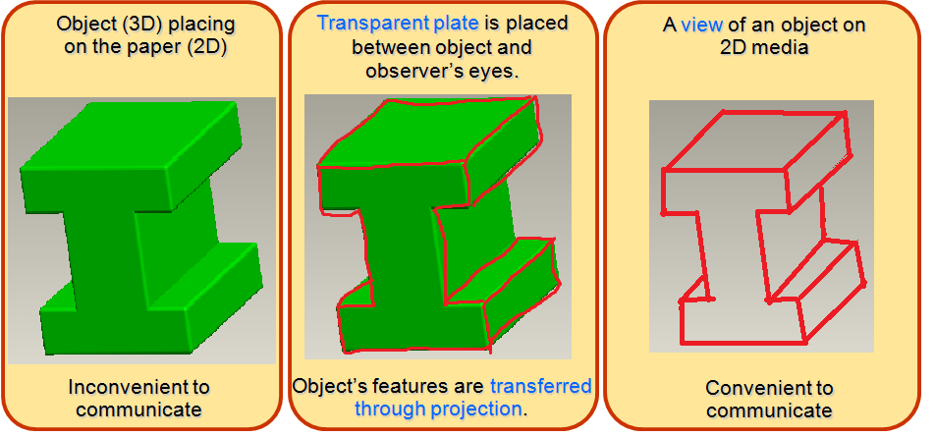
Projection Theory
Purpose : To graphically represent a 3-D object on 2-D media (paper, screen etc.).

Slide 35
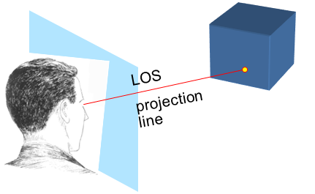
Concept
A projection theory is based on 2 variables:
1) Line of sight 2) Plane of projection (image or picture plane)
Line of sight (LOS)
is an imaginary ray of light between an observer’s Eye and an object.
Plane of projection
is an imaginary flat plane upon which the image created by the LOS is projected.

Slide 36
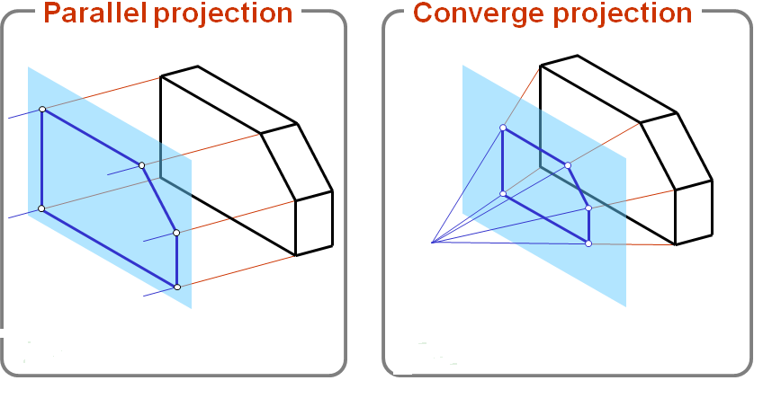
Line of sight
Lines of sight can be parallel or converge.

Slide 37
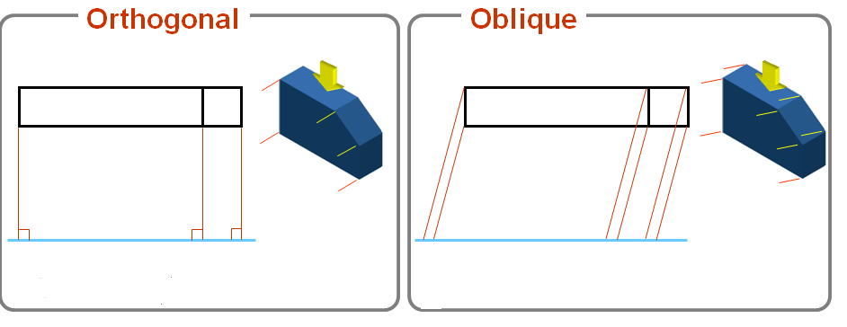
Line of sight
The parallel projection lines can be normal (orthogonal) or oblique to the plane of projection.

Slide 38
View
Image on a projection plane.
View depends on a relative orientation between an object and a plane.
Rotate
Multiview drawing
shows a 2D view of an object.
Tilt
Axonometric drawing shows a virtual 3D view of an object.
Multiview
Axonometric

Slide 39
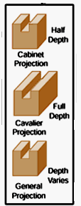
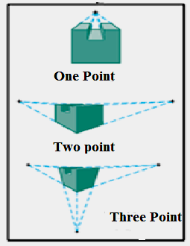
Types of views
Projections
Parallel
Converge
Orthogonal
Oblique
Perspective
drawing
Multiview
Axonometric
Multiview drawing
Pictorial drawing

Slide 40
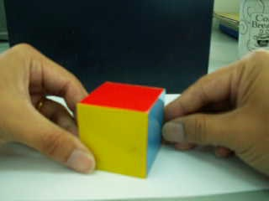
Type of an axonometric projection
a
1. Trimetric
Axonometric
axes
None of
the angles
are equal.
b
c
2. Dimetric
a
Two angles
are equal.
c
b
3. Isometric
a
All angles
are equal.
b
c

Slide 41
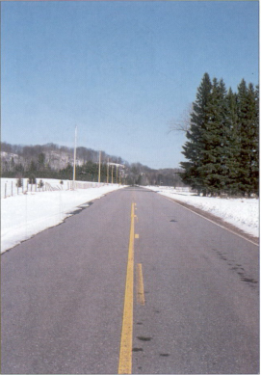
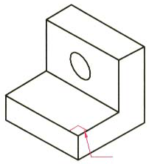
View Comparison
Type
Advantage
Disadvantage
Multiview drawing
Accurately presents object’s details, i.e.
size and shape.
Require training
to visualization.
Pictorial drawing
Easy to visualize.
Shape and angle distortion
Circular hole becomes ellipse
Right angle becomes obtuse angle.
Perspective drawing
Object looks more like what our eyes
perceive.
Difficult to create
Size and shape distortion
Distorted
width

Slide 42
Isometric projection
The projected lengths of the edges parallel to the axonometric
axes are approximately 81% of their true length.
3-D object (Cube)
Isometric view
a
a
0.8a
0.8a
a
0.8a

